Slide 1
Retail Data Analysis Project

Slide 2

Introduction: I have downloaded this retail data set from Kaggle to demonstrate the data analysis skills. Goal: To generate a sales reports with the sales data on hand. Question: Which store in does the best in terms of the sales revenue?

Slide 3

Table of Contents
1. Process
a. Microsoft Excel
b. Power BI
2. Overview of the Data
3. Insights

Slide 4
Process: Microsoft Excel
The dataset downloaded from Kaggle was cleaned in Microsoft Excel. Then I used Power BI to create an interactive dashboard.
Microsoft Excel
I used Microsoft Excel to clean my dataset. I have 3 tabs under the excel workbook and following columns in each tab:
3 Tabs: Sales dataset, Features dataset, and stores dataset

Slide 5
Process: Microsoft Excel
Data Cleaning Steps:
1. Autofitting- Click on the triangle on the top left corner to select all of the data, then click on the middle part of the columns (A, B, C…) and Rows (1, 2, 3…) to auto-adjust all the widths of the columns and rows for clearer views.
2. Identify and Remove Duplicates- Click on the column that should have the unique values to find and delete the duplicates. Click “Home” -> “Conditional Formatting” -> “Highlight Cells Rules” -> ”Duplicate Values..”-> “OK” to highlight the duplicate cells. Go to “Data” tab -> “Remove Duplicates” -> “OK” to remove the duplicates.
3. Align Columns to the Left- Click the triangle on the top left corner to select all data and click “Home” -> “Align Left” to align all the data to the left.

Slide 6
Process: Microsoft Excel
4. Change All Numerical Values from Format “General” to Format “Numbers” and Increase Decimals to 2 Spaces- Click on the columns that need to change the numerical format and click “Home”-> go to dropdown menu “General” and click "Numbers” to change the format of the columns. And click “Increase Decimal” to increase decimal to 2 places.

Slide 7
Process: Power BI
Power BI
Next I create an interactive dashboard in Power BI to show sales performance. I included the following metrics:
1. Sum of weekly sales revenue by year
2. Sum of Weekly Sales
3. Sum of Weekly Sales by Month
4. Sum of Weekly Sales by Store
5. Sum of Weekly Sales by IsHoliday
6. Sum of Weekly Sales by Type of Stores

Slide 8
Overview of the Data
Stores dataset: There are 45 stores in total.
Store: The numbers of stores
Type: The types of the stores
Size: The sizes of the stores
Features dataset: This dataset shows the additional information related to the store, department, and regional activities within the given dates.
Store: The number of the stores
Date: Date of the occurrences happened
Temperature: The average temperature of the given date in the region

Slide 9
Overview of the Data
Fuel_Price: The cost of fuel in the region
Markdown 1~5: The data related to promotional markdowns. Markdown data is only available after Nov 2011, and is not available for all stores all the time.
CPI: The consumer price index
Unemployment: The unemployment rate
IsHoliday: Whether the week is a special holiday
Sales dataset: The dataset’s date ranges from 2010-02-05 to 2012-11-01

Slide 10
Overview of the Data
Store: The store number
Dept: The department number
Date: the week
Weekly_Sales: Sales for the given department and store
IsHoliday: Whether the week is a special holiday week

Slide 11
Insights
• Weekly sales of department 91, 95, and 38 are performing significantly higher on the period of 2010~2012 and individually on yearly sales as well.
• Sales volumes are significantly higher on “not holiday” then on “holiday.”
• Type A has highest sales performance. B ranks second, and C ranks third.
• There is a positive correlation of sizes of stores and sales volume performance. (For 2010, 2011, and 2012 and all years combine.)

Slide 12
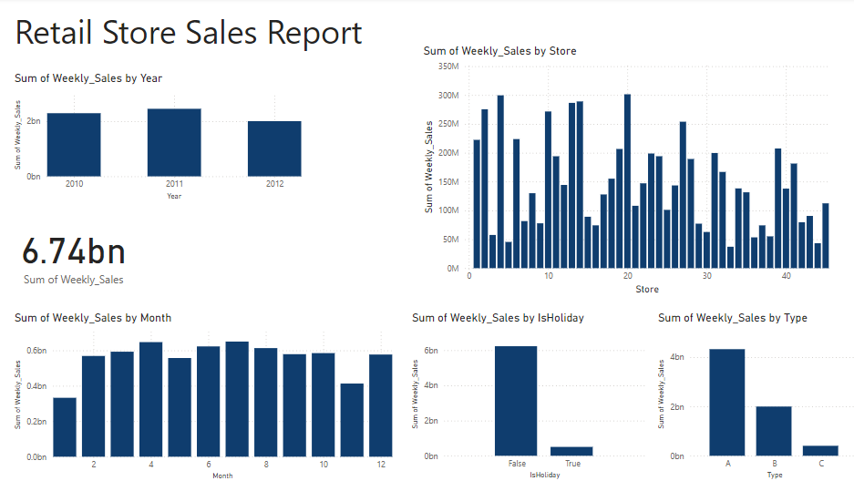
Insights- Power BI

Slide 13
Thank you
Anna Pan
annakpan@gmail.com

